Slide 1


framework Aggregation and Archiving of Artifacts
“A Repository of Reliable Resources for Academia”
FEASIBILITY PRESENTATION
CS 410, SPRING 2020
TEAM CRYSTAL

Slide 2
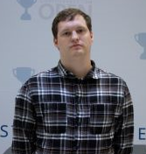



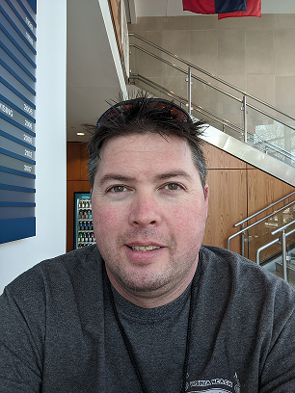
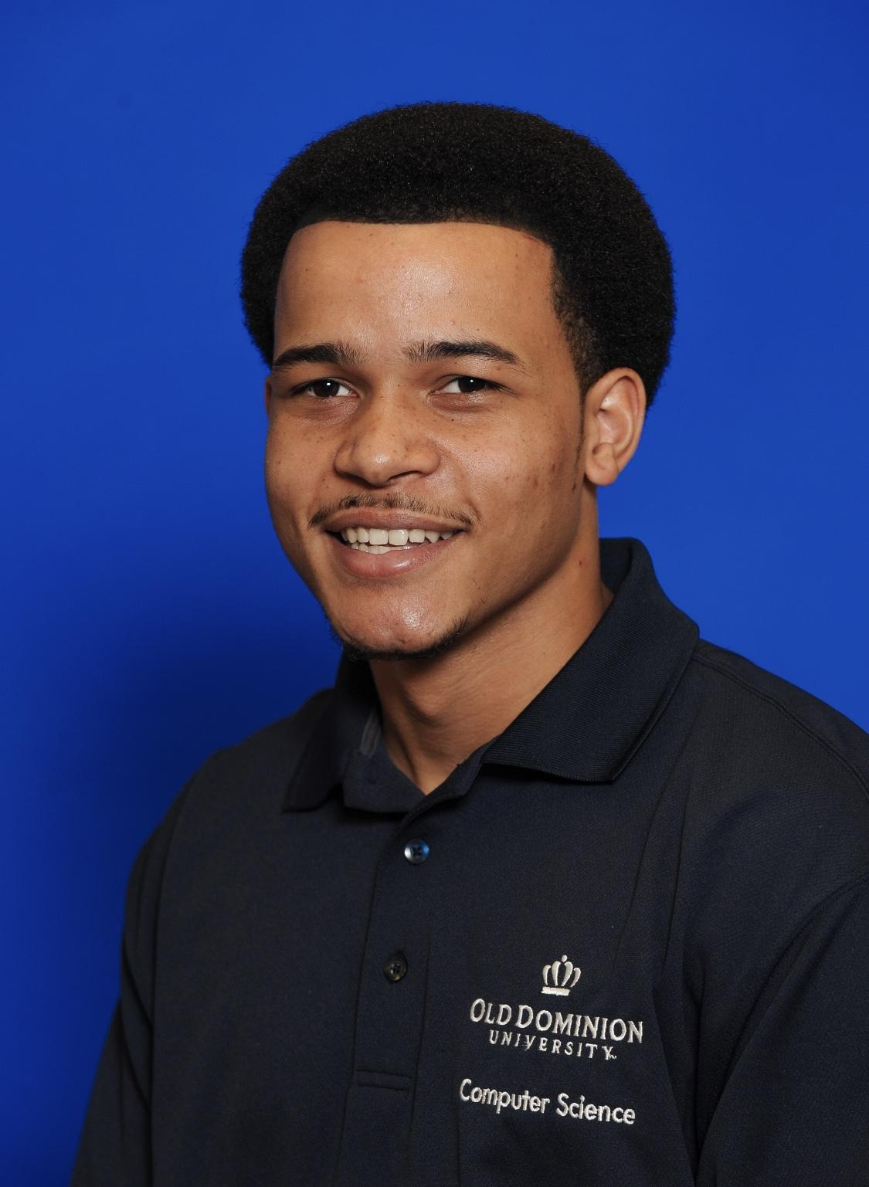

TEAM CRYSTAL
Team Crystal, comprised of computer science students at Old Dominion University, is developing the A³ framework.
Stephen Ayers
Algorithms Developer/Testing
Joshua Murphy
Documentation Manager/ Database Developer
Joshua Harris
UI/UX Developer-Testing
Mike Campbell
Database Architect/Testing
Aaron Berman
Team Lead/Webmaster
Noah Jennings
Algorithms Developer-UI/UX Developer
Rosalie Oliva
UI/UX Developer
Notes:
Stephen Ayers
introduce the team - everyone says their own name--mention the section you’re covering(?)add under name what section each member is focusing on
rosalie couldn’t make it

Slide 3

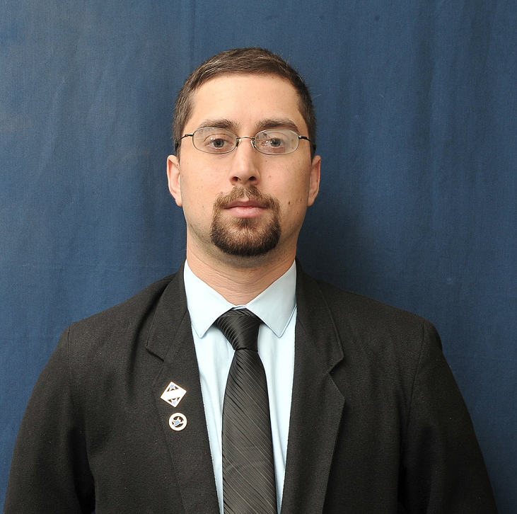
TEAM MENTORS
Janet Brunelle and Thomas Kennedy are both serving as mentors to Team Crystal in developing the A³ framework. Our mentors contributed heavily, explaining their needs and how other services have not been able to fill those needs. A³ seeks to fulfill those needs.
Janet Brunelle
Thomas Kennedy
Notes:
stephen Ayers

Slide 4
OUTLINE
Problem Statement
Traditional Shortcomings
Current Process Flow
Solution Statement
Solution Characteristics
Solution Process Flow
User Roles
Major Functional Components
Competition
Development Tools
Work Breakdown Structure: Overview
Site Map
Work Breakdown Structure: Algorithms
Work Breakdown Structure: Retrieval
Work Breakdown Structure: Analysis
Work Breakdown Structure: Security
Work Breakdown Structure: Filtering
Work Breakdown Structure: Database
Work Breakdown Structure: External Interfaces
Work Breakdown Structure: Testing
Data Management
Agile Sprints
GUI Mockups
Risk Matrix
Conclusion
References
Appendix A: User Stories
Appendix B: Glossary
Appendix C: Additional Material
Notes:
Stephen Ayers

Slide 5
PROBLEM STATEMENT
Educators and students lack a framework to aggregate and archive fragmented and domain-specific artifacts for the purpose of academic knowledge management.
Notes:
Stephen
-brunelle mentioned using example of current covid-19 issue, faculty moving to online some without experience on that medium
-faculty have content archives, but the knowledge artifacts aren’t centralized or easy to share with students and other faculty

Slide 6
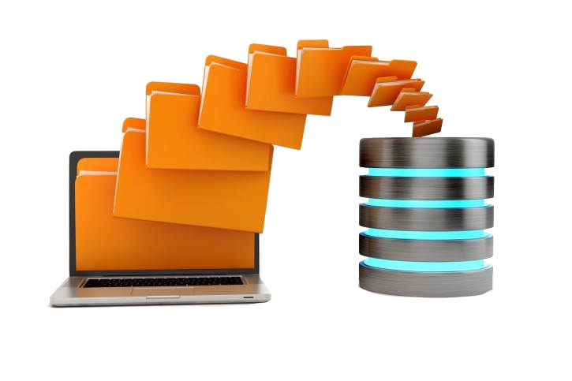
TRADITIONAL SHORTCOMINGS:
Knowledge Repositories
Formal artifact aggregation in traditional academic environments does not exist [3]
The aggregation that does currently exist does not support tracking of changes [2]
Current aggregation is not strong enough to be considered centralized
Image Credit:
(Medium.com 2020)

Slide 7

TRADITIONAL SHORTCOMINGS:
Knowledge Accessibility
Knowledge is isolated by specialization [16]
Access is often restricted by course or major [16]
Format preference by instructor can vary wildly and may not be functional to others [17]
Image Credit:
(Vecteezy.com 2020)
Notes:
Harris
-bolded headers change to shortcomings/issue area
-suggestion to split 6/7 into 4 slides (4 topics, one slide each)

Slide 8

TRADITIONAL SHORTCOMINGS:
Knowledge Asset Management
Instructor materials are often created in variety of formats
Individual instructors must often be petitioned for information [17]
Loss of artifacts from reassignment of responsibilities [16]
ODU CS department syllabi collection once took two months [17]
Image Credit:
(Freepik.com 2020)
Notes:
Harris

Slide 9

TRADITIONAL SHORTCOMINGS:
Knowledge Environment Enhancement
Reference materials are specific to each course
ODU instructors use a variety of platforms (Bb, PLE, CoWeM) [17]
Special needs and distance learning lack proper support [3]
Shared reference material can benefit organizations on a fundamental level [16]
Image Credit:
(shutterstock.com 2020)
Notes:
Harris

Slide 10
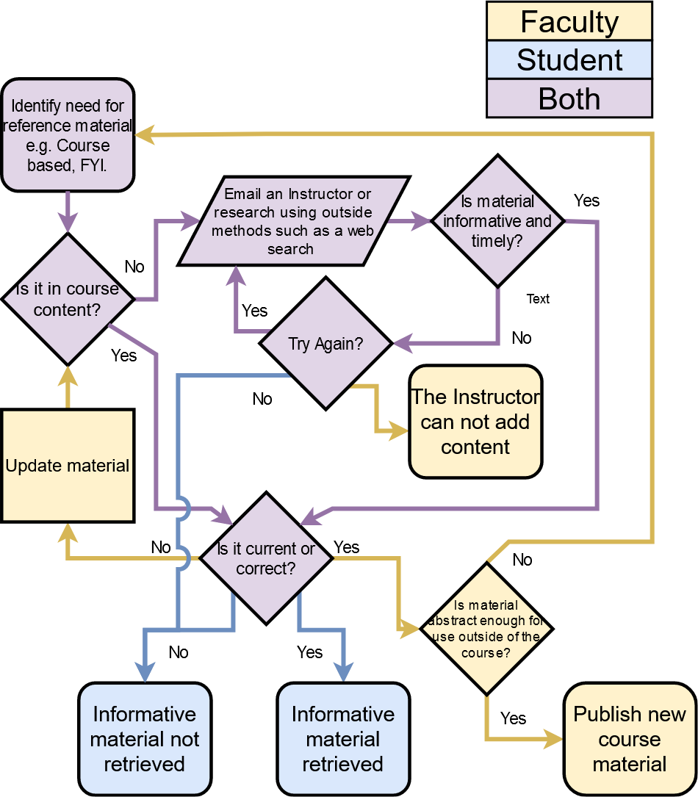
CURRENT PROCESS FLOW
The process flow when viewed from a comprehensive standpoint

Slide 11
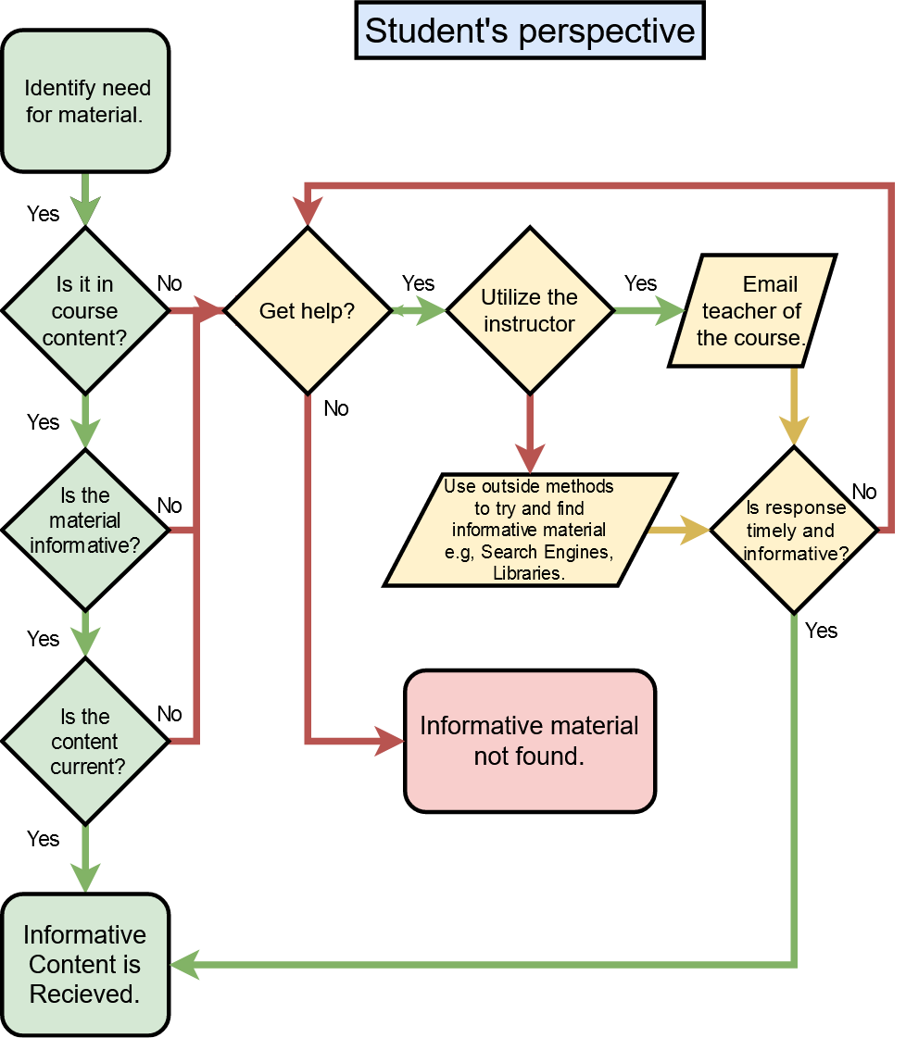
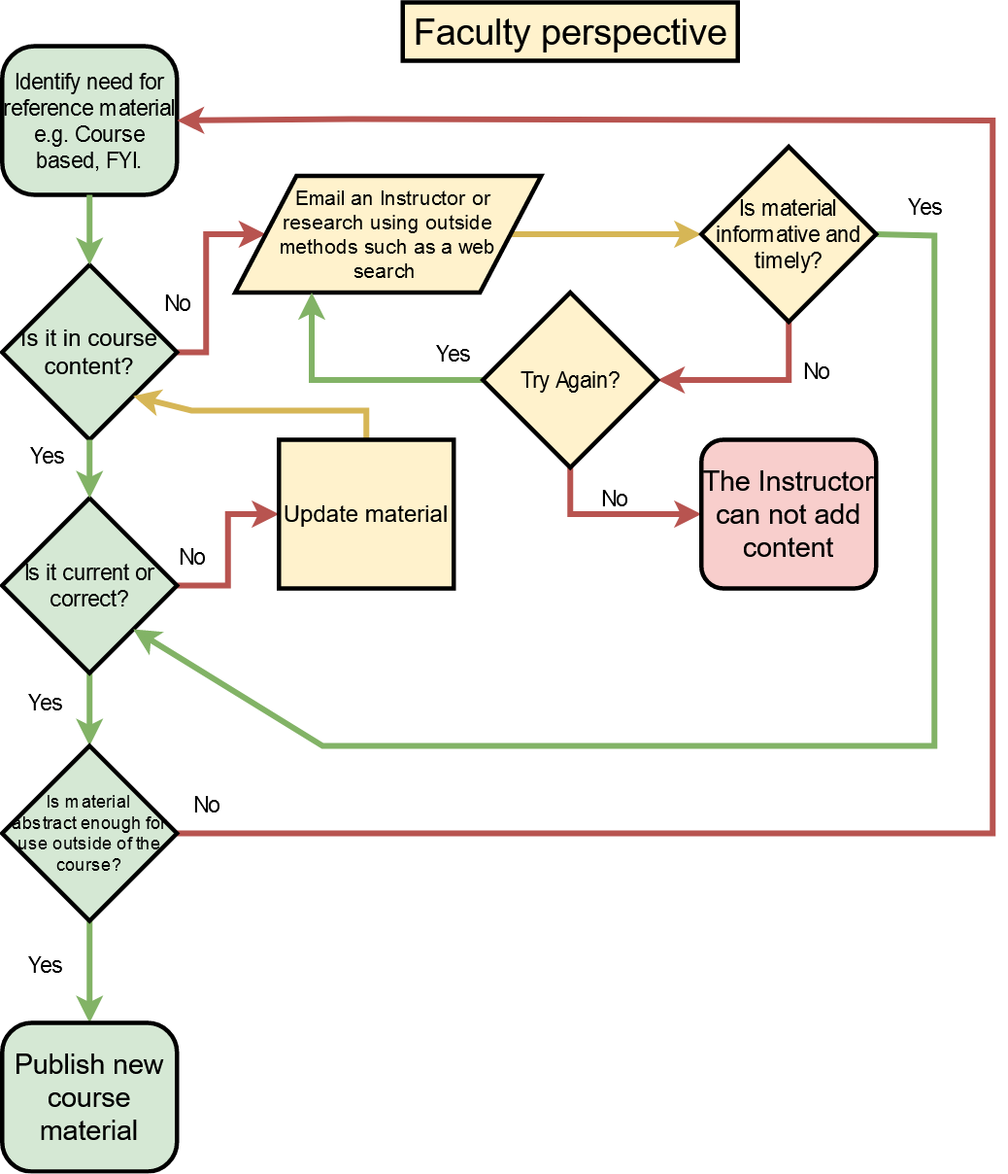
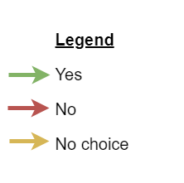
Notes:
Harris

Slide 12
SOLUTION STATEMENT
A³ is a framework for aggregating and archiving artifacts for educators, researchers, and students. A³ seeks to overcome the challenges of individualization, location, and formatting in academic knowledge management by keeping information available, normalized, and centralized while being enhanced by a robust user interface.
Notes:
Stephen Ayers

Slide 13
SOLUTION CHARACTERISTICS:
Creating Formal Knowledge Repositories
Create a robust infrastructure for artifacts
Support change logs of artifacts and knowledge assets
Centralize information concisely and effectively
Image Credit:
(Medium.com 2020)
Notes:
Mike
A-cubed aims to create a robust, reliable infrastructure as a repository for knowledge artifacts…
...which will support recording changes to those artifacts for review and analysis.
The repository is created as a centralized collection of knowledge assets, facilitating easier sharing of instructional materials.

Slide 14
SOLUTION CHARACTERISTICS:
Improve Knowledge Accessibility
Create knowledge artifacts that are widely applicable
Create a cross course accessibility
Normalize information from varied platforms (Blackboard, PLE, etc.) into translatable formats
Image Credit:
(Vecteezy.com 2020)
Notes:
Mike
Easier sharing means artifacts are more accessible.
Accessing knowledge will no longer be subject to delays from back-and-forth communications because users will have direct access to the artifacts. Faculty have enough to juggle, A-cubed aims to take a ball or two out of the air.
Normalizing, standardizing artifact formats across platforms means instructors can easily include artifacts from other courses as supplemental content, providing students with more complete understanding of the material.
Consider a Computer Science course about the history and development of programming languages. The instructor using A-cubed could easily pull up-to-date examples from a course focusing on C++ rather than having to create the same, possibly identical, content from scratch.
Instructor Jim Brunelle publishes weekly materials in various formats for his students.

Slide 15
SOLUTION CHARACTERISTICS:
Knowledge Asset Management
Unify formatting among instructors through normalization
Remove necessity of individual asset request
Create systematic storage of vital course information
Automate collection of standard reference materials
Image Credit:
(Freepik.com 2020)
Notes:
MIKE
Instructors don’t have to consider format choices when sharing materials--just use what works best for them, not only file types, but platforms, as well.
Recall the earlier example of the history of programming instructor complimenting their course materials with artifacts from a C++ course…
...a student accessing that information doesn’t have to go through the platform used by the C++ course, be it PLE, Blackboard, or another--they simply get direct access to the artifact.
The need for students to request individual knowledge assets from instructors is removed,
because the students gain direct access to the collection of artifacts.
This benefits students because of the quicker access to knowledge, but also consider the time saved for the instructor--no longer flooded with emails requesting course materials.

Slide 16
SOLUTION CHARACTERISTICS:
Knowledge Environment Enhancement
Create universal reference material standards
Core organizational improvements through a cooperative environment
Normalization to allow cross platform functionality
Special needs and distance learning accessibility
Image Credit:
(shutterstock.com 2020)
Notes:
MIKE
Standardizing content held in the repository improves usability and access, and allows for analysis.
Organizing artifacts is much simpler when they can be analyzed.
Normalized formats can be used on many platforms.

Slide 17
Normalization
Convert file types (e.g. pdf, txt, doc, docx) to markdown (md)
Allows for comparison or Diff
Allows for searchability
Allows for export as original file type
Allows for singular content search algorithm

Slide 18
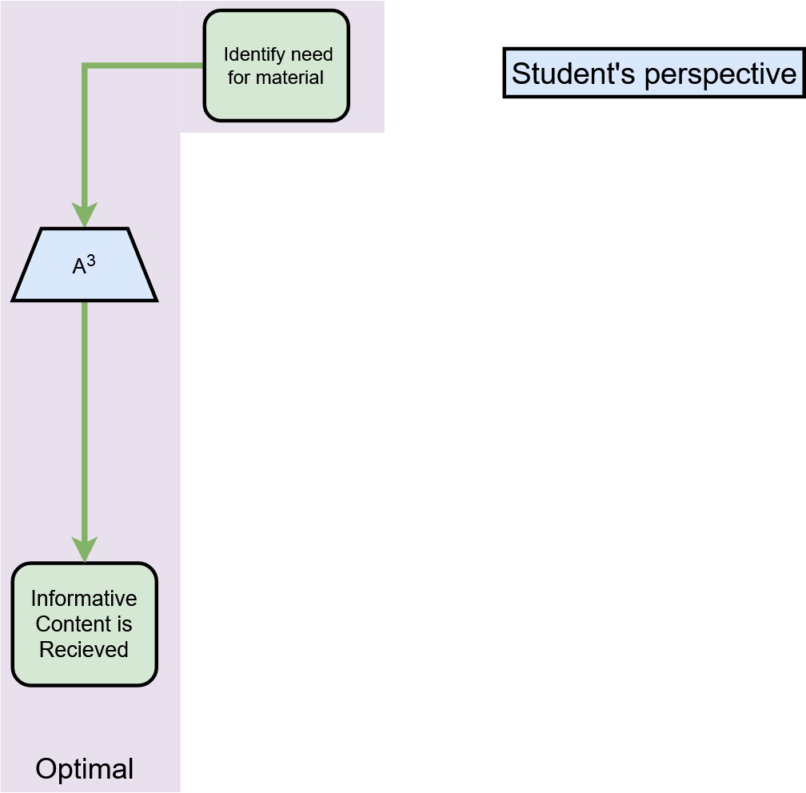
Notes:
Mike
As you can see, the process flow of the student experience is streamlined
optimizing effort, saving time for more last-minute homework

Slide 19
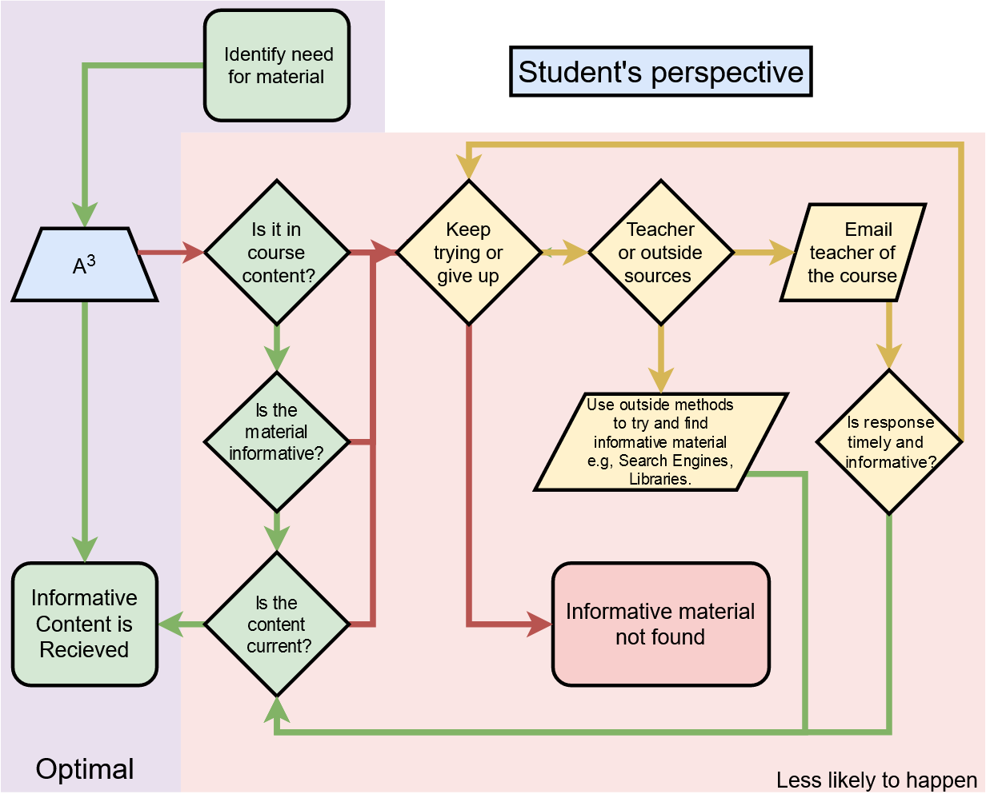
Notes:
Mike
not a panacea, just a tool to improve the process
Hitting a dead end is significantly less likely.

Slide 20
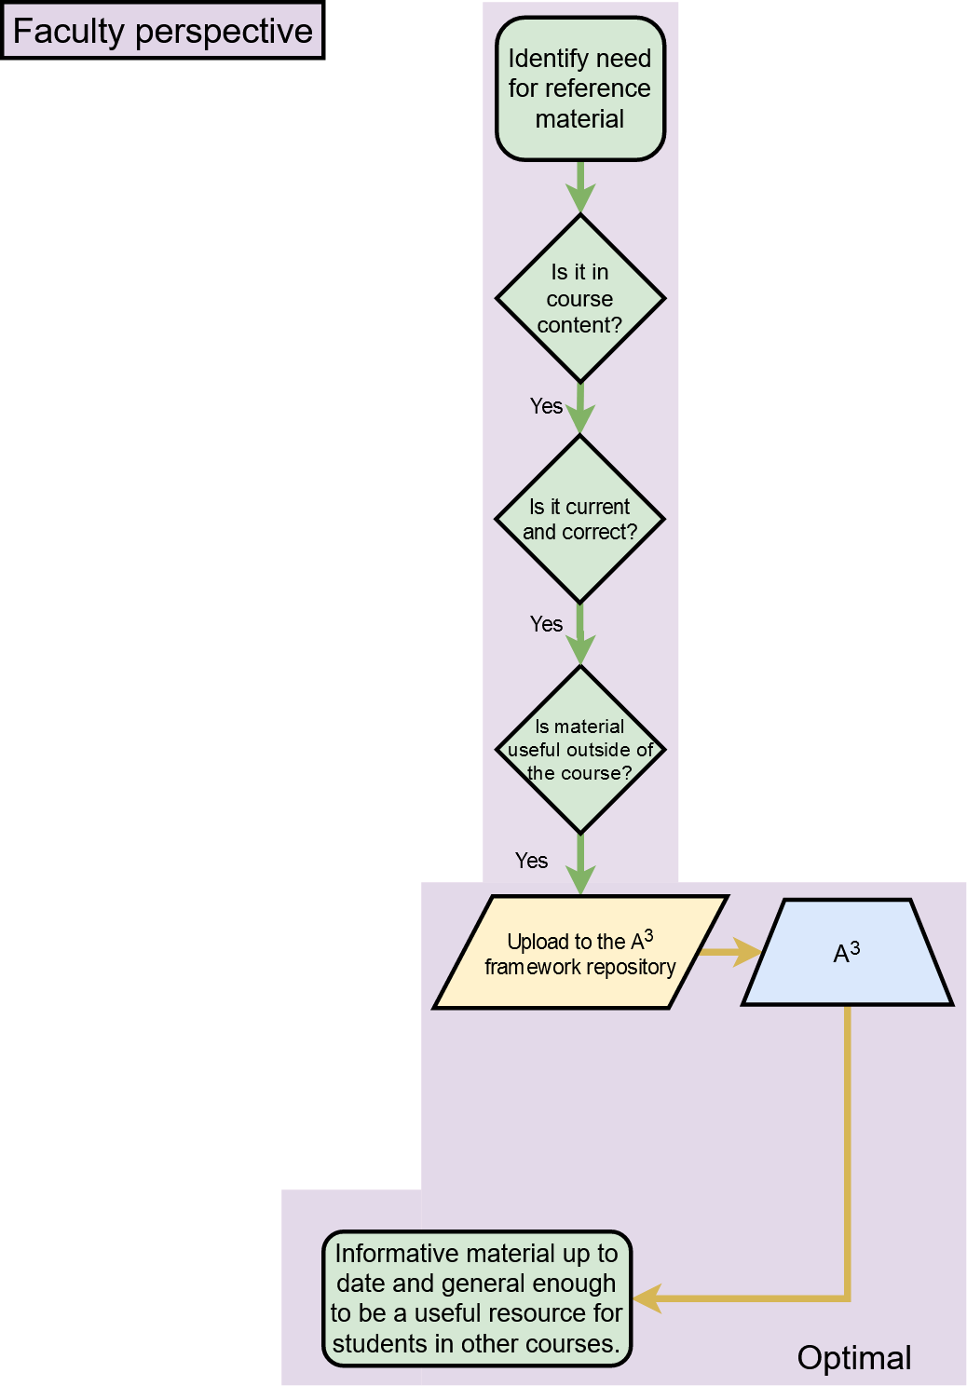
Notes:
Mike
the faculty experience is also simplified
sharing, storing artifacts is more efficient

Slide 21
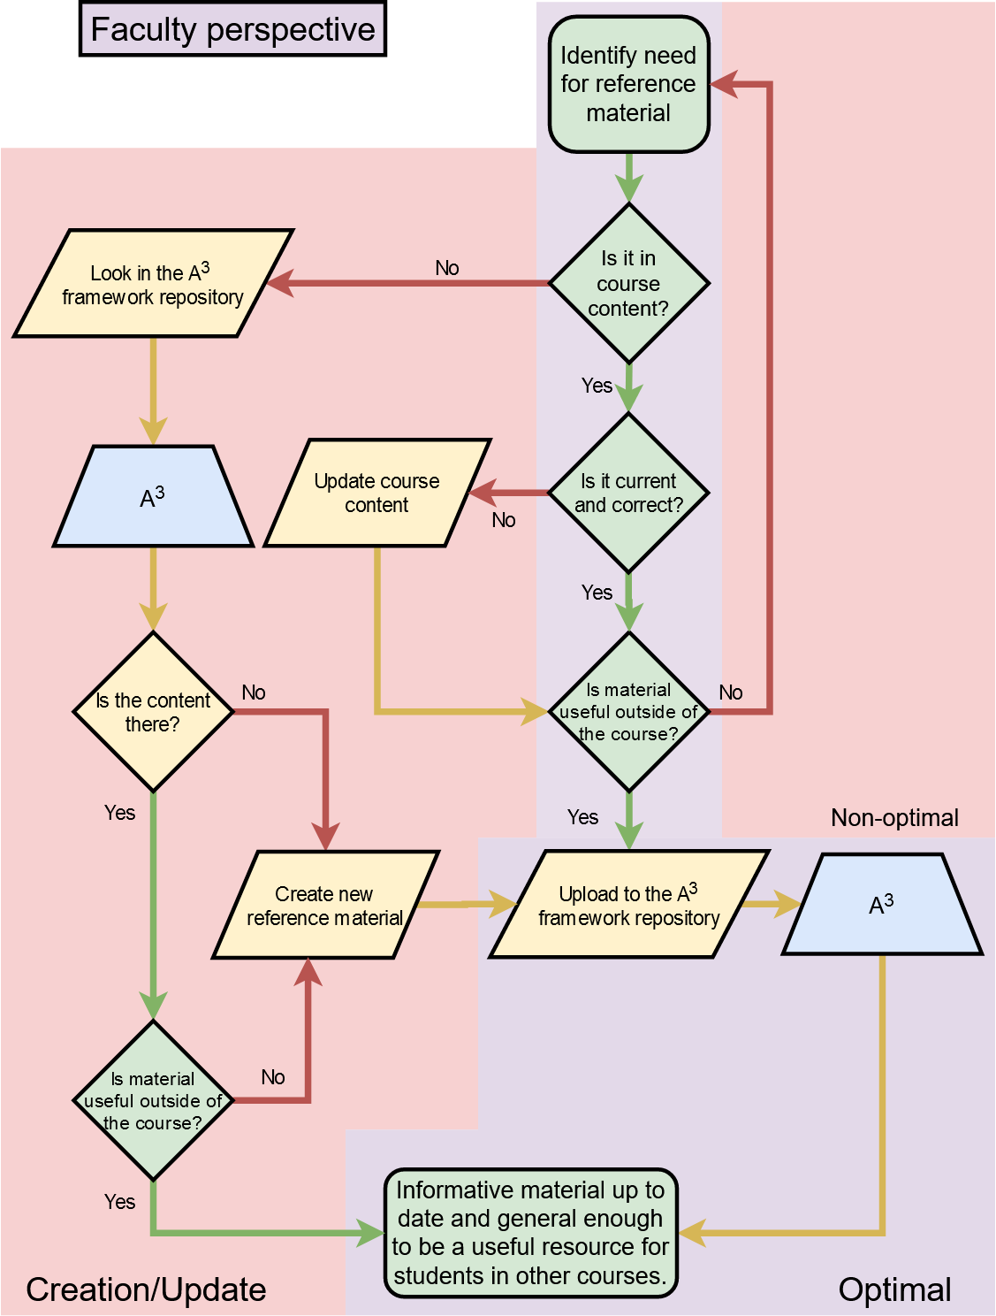
Notes:
Mike
missing content does add steps, but adding content to the course using A-cubed is designed to be easy
benefits grow as participation increases--the more instructors using A-cubed, the better it works for all users.

Slide 22
POTENTIAL USER BASE (Worldwide)
All Enrollments and Online Enrollments, 2016 and 2017
 | 2016 | % of 2016 total | 2017 | % of 2017 Total | % Change, 2016 - 17
All Students | 20,224,069 |  | 20,135,159 |  | -0.44%
Enrolled Exclusively Online | 2,974,836 | 14.71% | 3,104,879 | 15.42% | 4.19%
Enrolled in Some Online Courses | 3,325,750 | 16.44% | 3,552,581 | 17.64% | 6.38%
Enrolled in No Online Courses | 13,923,483 | 68.85% | 13,477,699 | 66.94% | -3.31%
Lederman, D. (2018, November 7). Inside Higher Ed. Retrieved March 10, 2020, from https://www.insidehighered.com/digital-learning/article/2018/11/07/new-data-online-enrollments-grow-and-share-overall-enrollment
Notes:
Stephen Ayers

Slide 23
STAKEHOLDERS & USER ROLES
Stakeholders - Academic institutions, Faculty, Researchers, Students (current and former), and any person who has a desire to learn from the content which has been stored.
User Roles:
Guest
Student
Faculty
Administrator
Tester
Access to public facing artifacts with search capabilities
Access to all Guest roles as well as Course specific artifacts
Access to all Student roles as well as ability to upload and update owned artifacts
Access to all Faculty roles as well as database administration capabilities
Access to Administration roles as well as test specific functionality to achieve a quality product
1
2
3
4
5

Slide 24
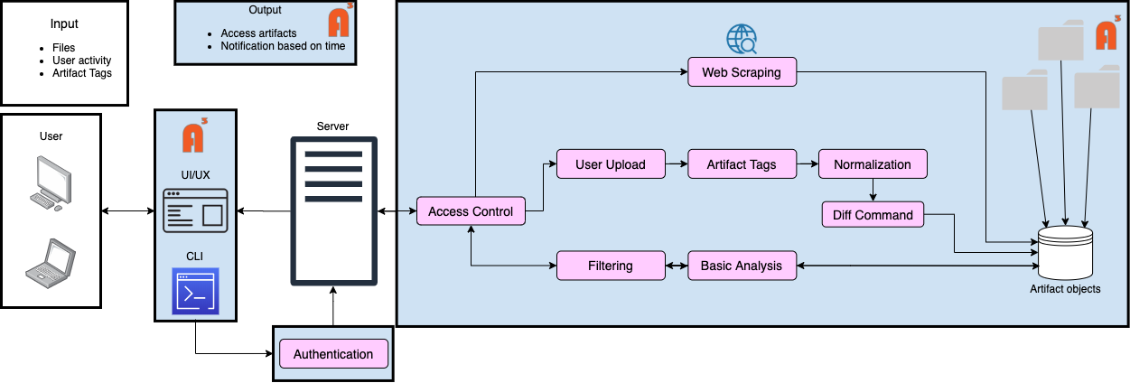
MAJOR FUNCTIONAL COMPONENTS
Algorithm
Asset
Notes:
Harris - Functional components
-need consistent capitalization

Slide 25
CURRENT COMPETITION
eFileCabinet - A centralized location for all documents and files. Allows for up to 5 TB of storage. The service can break files down into separate departments and folders. eFileCabinet also lacks in the ability to be locally hosted and controlled by system administrators.
Localized Databases - Databases can contain much of the same information. These are generally not easily accessible by many people due the difficulty included creating SQL queries and data retrieval.
FileCloud - A cloud-based solution to sharing files among students, faculty and administrators. Lacks the ability to be locally hosted and controlled a University.
Notes:
Noah Jennings
Sharepoint ??
what is it
what can it do
how well can it do these things
what can’t it do
why not
eFileCabinet
central location for files/documents with the ability to compartmentalize
lacking the ability to be hosted locally
cannot be controlled by systems admin
Local DB
recurring information
data retrieval and query
locally hosted and controllable
FileCloud
cloud-based file sharing solution
LIKE EFILECABINET lacks the ability to be locally hosted / controlled
GitHub
famous cloud based repo system
contribute to projects in a group/solo

Slide 26
CURRENT COMPETITION
GitHub - A cloud-based repository system for contributing to projects. This is an all-to-one system where the users all contribute to one project. Useful for Programing and its associated documentation.
SharePoint - A web-based platform that contains the tools of Microsoft Office while allowing collaborative work. Sharepoint is often presented as a document storage and management system, but is fairly customizable.
Notes:
Noah Jennings
Sharepoint ??
what is it
what can it do
how well can it do these things
what can’t it do
why not
eFileCabinet
central location for files/documents with the ability to compartmentalize
lacking the ability to be hosted locally
cannot be controlled by systems admin
Local DB
recurring information
data retrieval and query
locally hosted and controllable
FileCloud
cloud-based file sharing solution
LIKE EFILECABINET lacks the ability to be locally hosted / controlled
GitHub
famous cloud based repo system
contribute to projects in a group/solo

Slide 27
COMPETITION MATRIX
Features |  | FileCloud | Localized Databases | eFileCabinet | GitHub | SharePoint
File Storage | X | X | X | X | X | X
Change Tracking | X | X | X | X | X | X
Content Search by Filename | X | X | X | X | X | X
File Sharing | X | X |  | X | X | X
Change Reporting | X | X |  |  | X | X
Content Search by Subject | X |  |  | X | X | X
Notifications | X |  |  |  | X | X
Reports | X |  |  |  |  | X
Format Normalization | X
Automation | X
Mandatory Configuration |  | X | X | X | X | X
Notes:
Noah Jennings
Key Functionalities of our competition
UI ???
CLI ???
Differences???
least - > greatest
reports was Content by Date
-refers to retrieving details about repository, last accessed files, last changed, access frequency
notifications was Automated Materials Request
-refers to users setting reminders to update their content as applicable
Reports
periodical diff
analyze the state of resources over time
designated by the user or SUM_TIME by defaul

Slide 28
WHAT A³ WILL DO AND WILL NOT DO
A³ will…
Allow users to view changes to an artifact
Link artifacts to the original source
Allow users to convert documents to markdown for normalization
Automate the update of artifacts
A³ will not…
Allow users to edit archived artifacts
Provide server hosting
Require document templates
Provide continuous integration

Slide 29
DEVELOPMENT TOOLS
Software Requirements:
Language: Python 3.8 or newer
GUI language: HTML, CSS, and JS
JS frameworks: Angular and React
IDE: Visual Studio Code (VS Code)
Documentation: pydoc and Sphinx
Code Repository with Version Control: GitLab
Containerization: Docker and Docker Compose
Database: MySQL
APIs: REST
Configuration management: tox
Analysis: pycodestyle (formerly PEP 8) and Pylint
Hardware Requirements: Single instance server

Slide 30
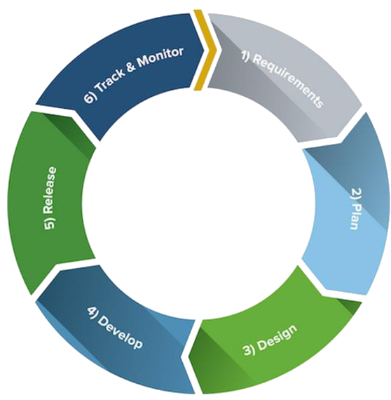
DEVELOPMENT MODEL - AGILE
Small team with distributed knowledge
High quality product
Known customer who can provide immediate feedback
Fast return on investment (ROI)
After the first sprint, the A³ deliverable will be actively used for future sprint development.
Agile Software Development
Image Credit:
(Smartsheet 2020)
Notes:
a cubed as the foundation of future sprints
#after the first sprint, the basis framework will be used to continue developing A^3

Slide 31
WORK BREAKDOWN STRUCTURE:
Overview
GUI
Algorithms
External Interfaces
Database
Testing

Slide 32
SITE MAP
Authenticate credentials
Guest
Student
Faculty
Administrator
Tester
Sort, filter, display artifacts
Guest Capabilities
Student Capabilities
Faculty Capabilities
Administrative capabilities
Read artifacts
Create/Export Bookmarks
Upload/update artifacts
Access all artifacts
View reports about users and artifacts
Download artifacts
Manipulate owned artifacts
Manipulate all artifacts
Analyze results
Grant artifact access
Manipulate all users
Report test problems
Invite new user
Notes:
tester track.

Slide 33
WORK BREAKDOWN STRUCTURE:
^{Algorithms}
Data Retrieval
Data Analysis
Security
Filtering
Notifications
User Upload
Web scraping
Normalization
Authentication
Artifact Tags
Invitations
Alterations
User Export
Diff Command
Permissions
Notes:
repo scraping and flat directory scraping/ archive scraping and web scraping are part of data retrieval

Slide 34
Data Retrieval Algorithm:
User Upload
Desire & permission to archive artifact
Gather artifact & attributes(s)
Attributes exist?
Yes
No
User upload is available upon request to authenticated users
SFTP
Normalizes specified file types (e.g. .txt, .pdf, .doc)
Creates new entries or updates existing ones
Yes
Normalizable file type?
Yes
Correct format?
Normalize file
No
No
Update specified?
Yes
Reject Upload
No
No
Artifact exists?
Create archive entry
Database storage
Update & Diff
Yes
Notes:
Faculty and up can upload
what file type are they uploading ?
Normalizable ?
yes
normalize
continue
no
continue
Have they done this before ?
Yes
update
find version differences
record version differences
store in A³
No
User inputs different artifact attributes
continue until correct formatting is achieved
store in A³ once satisfied

Slide 35
Data Retrieval Algorithm:
Web Scraping
Request for update
Resource updated and
Contributors Notified
User owned or permitted artifact?
Normalize
Update & Diff
No
Web Scraping is issued on a set interval
Allowed after backlink has been established
Pulls resources from URL, checks update tags, converts to .md, calculates Diff, and updates
Yes
No
Artifact has original source?
No
Yes
Can be normalized?
Yes
Reject request
Gather artifact backlink
Gather update confirmation
Yes
No
Current state more recent?
Yes
Attempt to crawl backlink
No
Reject request
Yes
Server connection?
Yes
Artifact located?
No
Crawl backlink
No
Notes:
User creates request to update an artifact/repo of artifacts
checks accessibility to artifact
unallowed ?
reject request
allow ?
check artifact tags for original source
does not have ?
gather
-> has
has ?
attempt to crawl
server connect?
no ? r
reject request
yes?
crawl
unable to locate artifact ?
quit
able to locate artifact ?

Slide 36
Data Analysis Algorithm:
Basic Analysis
Provides basic artifact information, i.e., upload date, file type, owner ID, past versions
Is only available to instructor and above levels of permissions
Used to track artifact resources from a management perspective
Request file information
Artifact valid?
Yes
Does user have permission?
Yes
No
Reject request
No
Create SQL query
Display information
Provide information to the UI/UX
Retrieve information from database

Slide 37
Data Analysis Algorithm:
Normalization
Capture .md format
Convert to Markdown
Artifacts are normalized before being stored into A³
Certain file types cannot be normalized, but may still be stored
Pandoc can be used to create markdown files that can be easily compressed
Request to normalize artifact
Is artifact valid?
Yes
Does user have permission?
Yes
No
No
Reject request

Slide 38
Data Analysis Algorithm:
Diff Command
Request comparison
Display differences
Used to show changes in artifacts over iterations
Files must be normalized into Markdown to be compared
Available to all levels above guest
Are artifacts valid?
Yes
Sort relevant information
No
Reject request
Calculate Diff
Notes:
save versions vs save changes
-Request comparison
>check valid
>no: end
>yes: check if normalized
>yes: diff and compare artifact attributes
-display differences
>no: diff unavailable, compare artifact attributes
-display differences

Slide 39
Security Algorithm:
Authentication/Access Control
Authentication is a simple handshake when a user of any level accesses A³
Verifying permission levels is coupled with what individuals can view, e.g., which private and public files
Gather user attributes
Yes
Password
correct?
No
Login
rejected
Permit access
Gather permissible artifacts & repos
Yes
User login attempt
Gather access credentials
Recognized username?
No

Slide 40
Filtering Algorithm:
Artifact Tags
No
Desire to filter displayed artifacts
Filter(s) specified?
No
Yes
Gather filter tag(s)
Gather permissible artifacts
Display
artifacts
Check formatting
Request to filter tags during search
Gather and analyze tags/accessibility before display
Reject display
Correct format?
No
Yes
Empty display
Artifact(s) exist?
Yes
No
Notes:
alg_sort
cin >> tags_user_input //allows multiple entries
if (tags_user_input == "")
//depending on search parameters
return all artifacts
else if (tags_user_input != regex formatting check)
return error message
print all artifacts from (query A3.tag where tags_user_input is TagName)

Slide 41
WORK BREAKDOWN STRUCTURE:
^{Database}
Repository
User Profiles
Owner
Report
Artifact
Guest
Date/time of last access
Date and time of fetch
Change Diff
Source link
Student
Faculty
Administrator
Tester

Slide 42
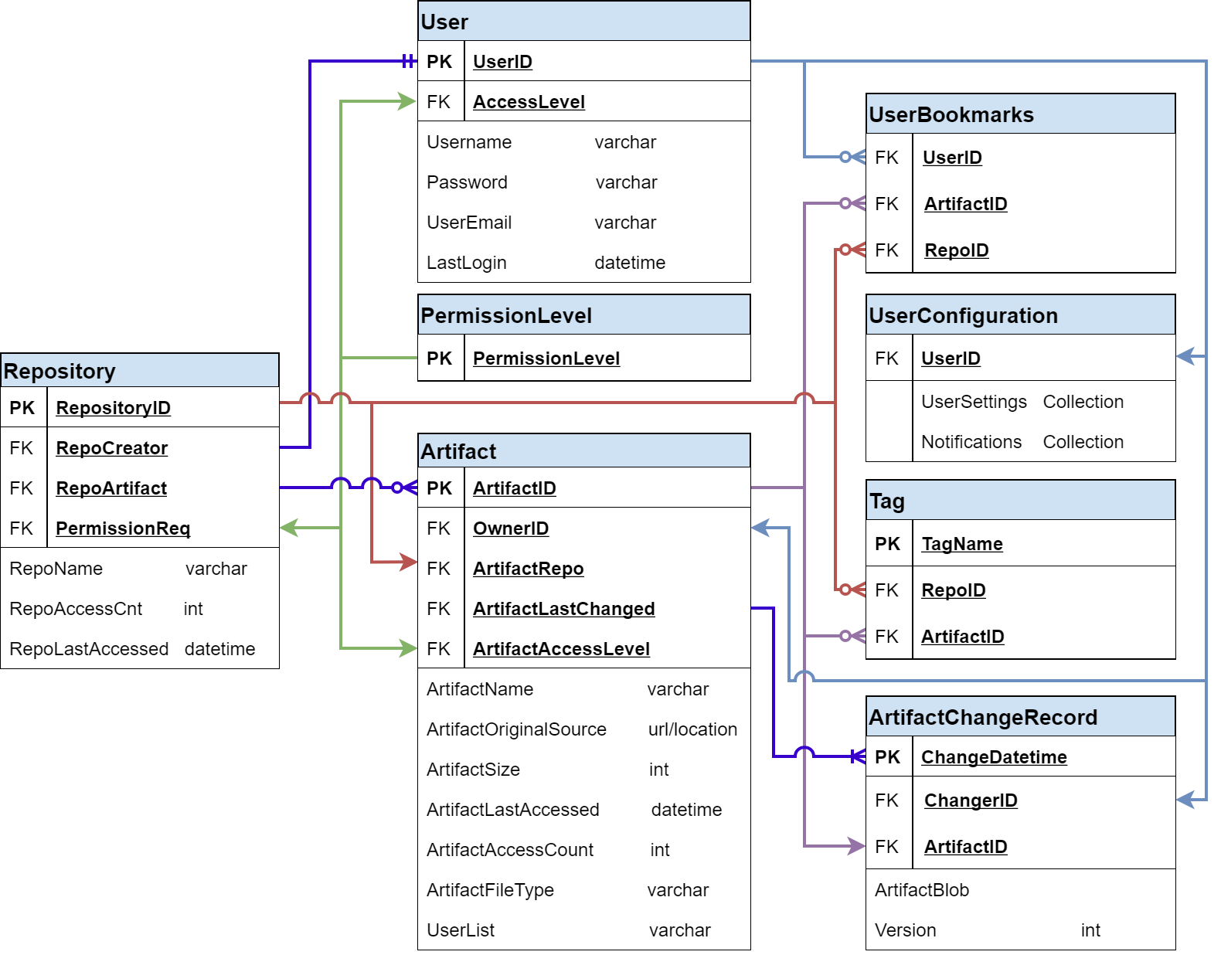
DATABASE:
Schema
Notes:
SHOULD WE ADD CREATION DATE/VERSION OF THE ARTIFACTS, ALONG WITH ITS CHANGE RECORD ??
noah
change record
change date
user id that changed it
artifact id that was changed
need to return to older versions ?
change log ?
gzip, blob
#add repo bookmarks -added
#artifact location -added

Slide 43
WORK BREAKDOWN STRUCTURE:
External Interfaces
SFTP
Web Scraper
Artifacts selected for uploading

Slide 44
WORK BREAKDOWN STRUCTURE:
Testing
Unit Tests
Integration Tests
System Tests
Acceptance Tests

Slide 45

DATA MANAGEMENT:
User Authentication
Username and password combination
Access control
Role-Based Access Control (RBAC)
Data Availability
Storage of artifacts for archival purposes
Image Credit:
(flaticon.com 2020)

Slide 46
AGILE SPRINTS
Sprint 1
Sprint 2
Sprint 3
Sprint 4
Sprint 1
Database framework
CLI functionality
Normalization function(s)
Simple comparison function
Authentication
Testing
Sprint 2
Diff function (line-by-line)
Analysis function(s)
Testing
Sprint 3
Guest accounts
Student accounts
Testing
Sprint 4
UI/UX
Additional features, e.g., notifications
Testing

Slide 47
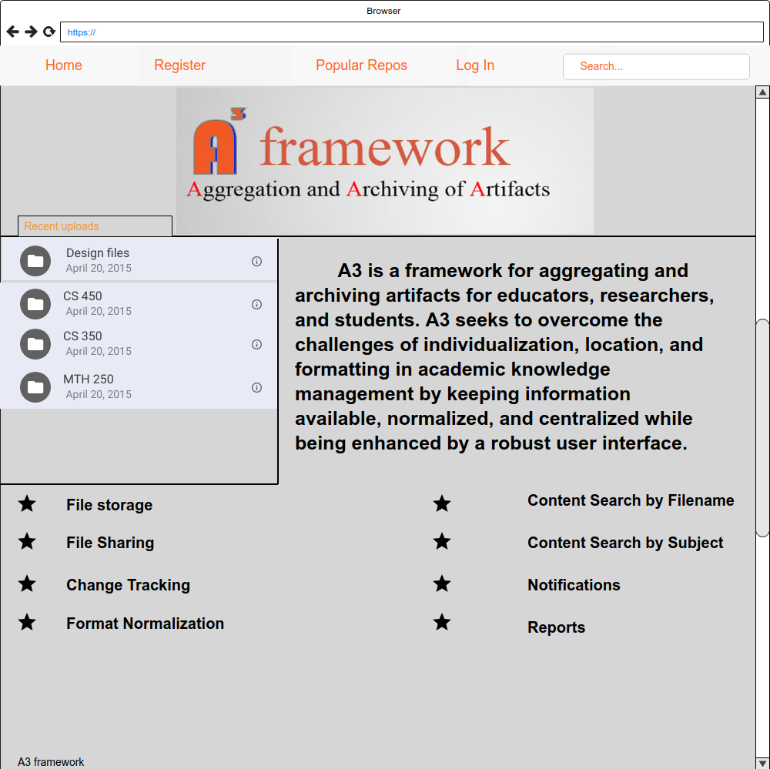
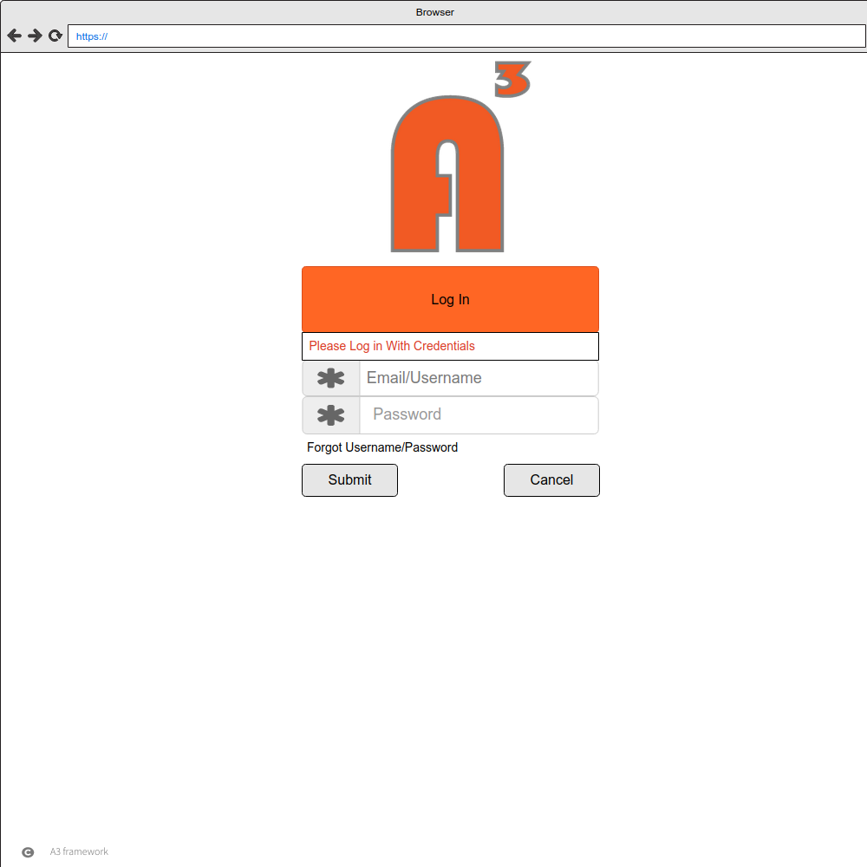
GUI MOCKUP:
A³ Homepage/ Login
Notes:
-remove competition matrix. prefer features

Slide 48
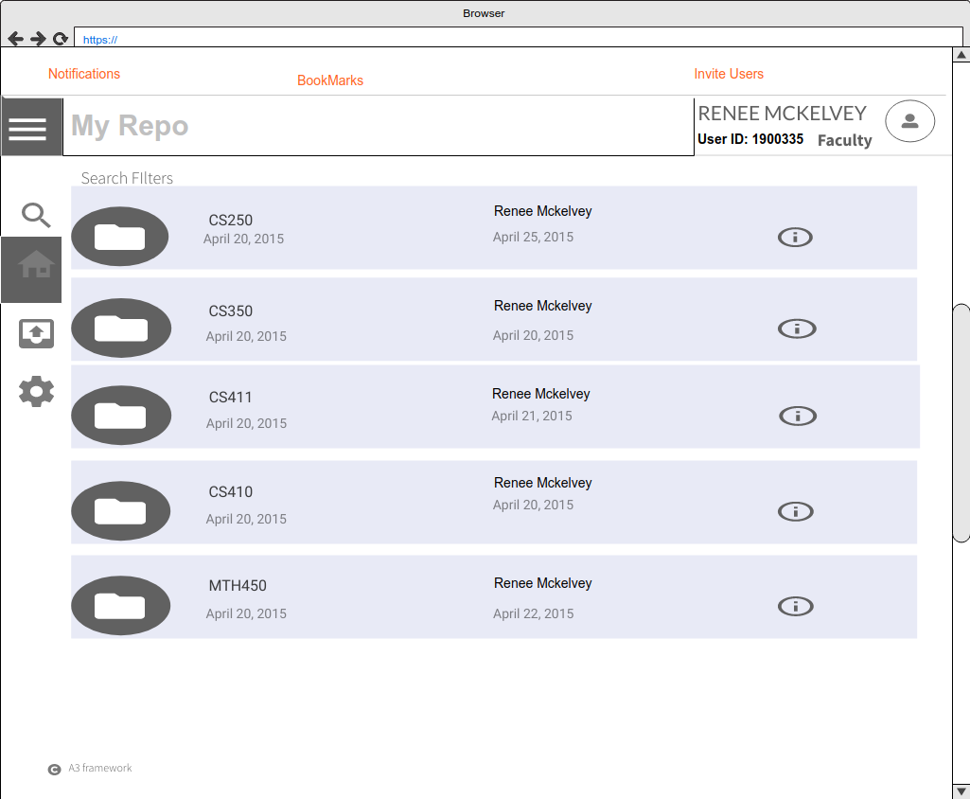
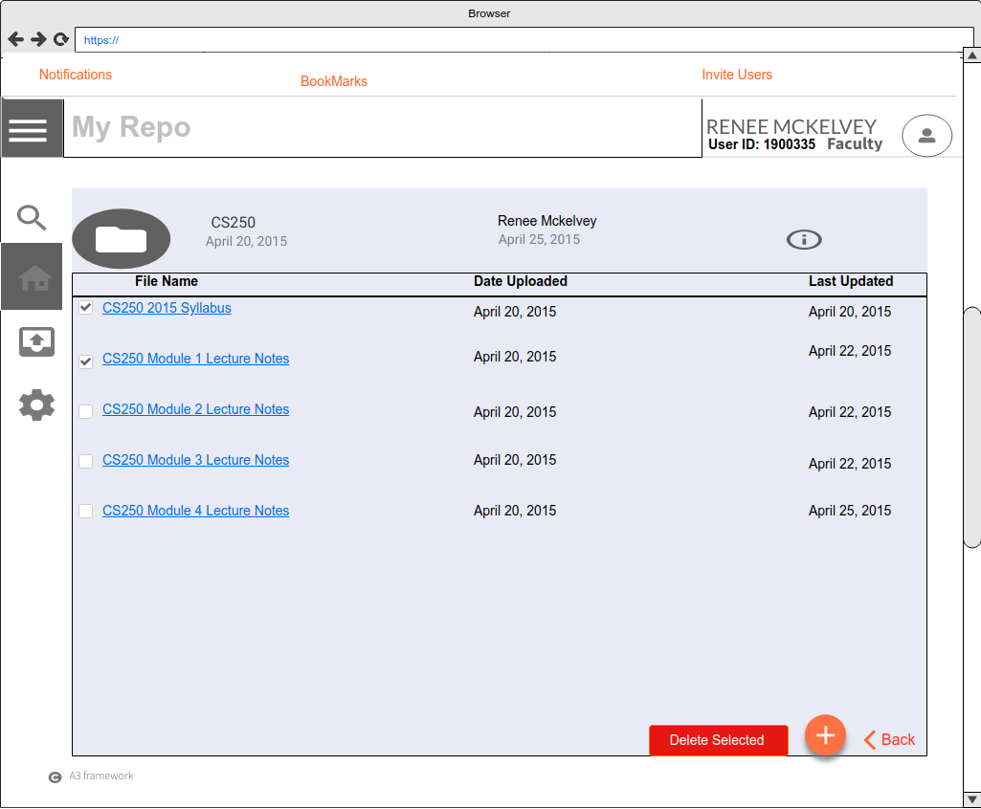
GUI MOCKUP:
User Homepage/Repo View

Slide 49
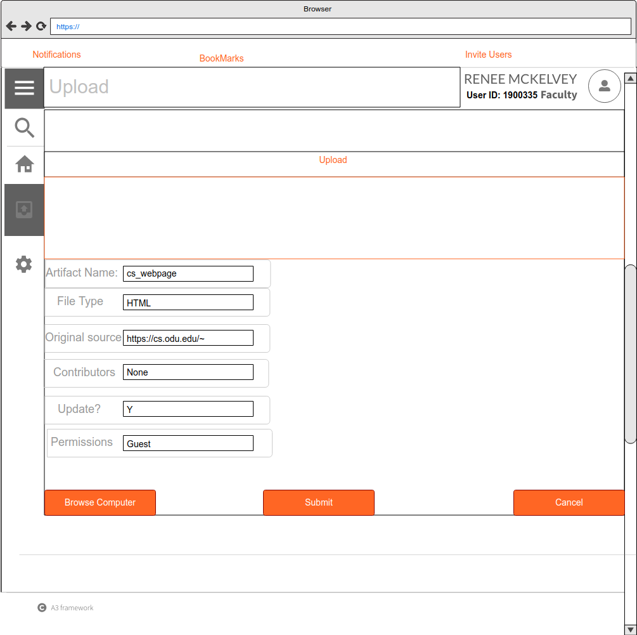
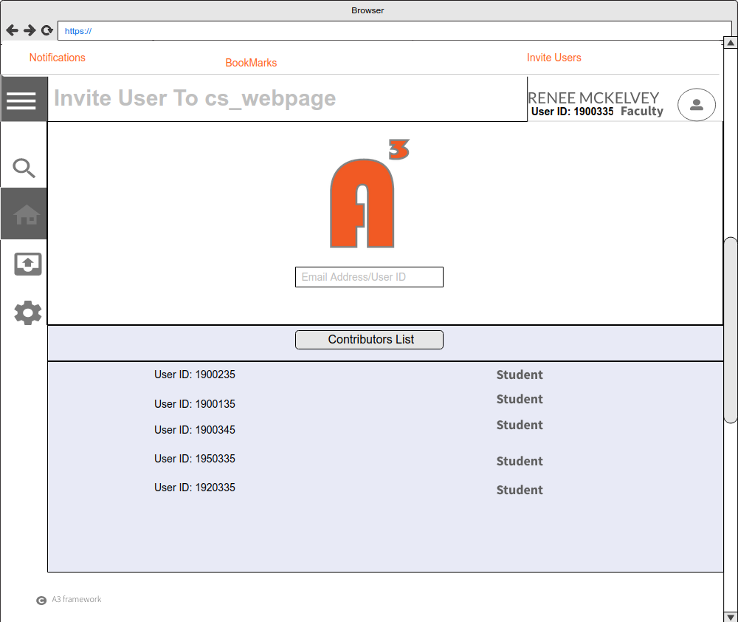
GUI MOCKUP:
Upload / Invite New User
Notes:
invite through email. is that maintain in your database?
looking for the file updated.
invitation of user in site map and algorithm ? *Add Privacy *change simply to upload

Slide 50
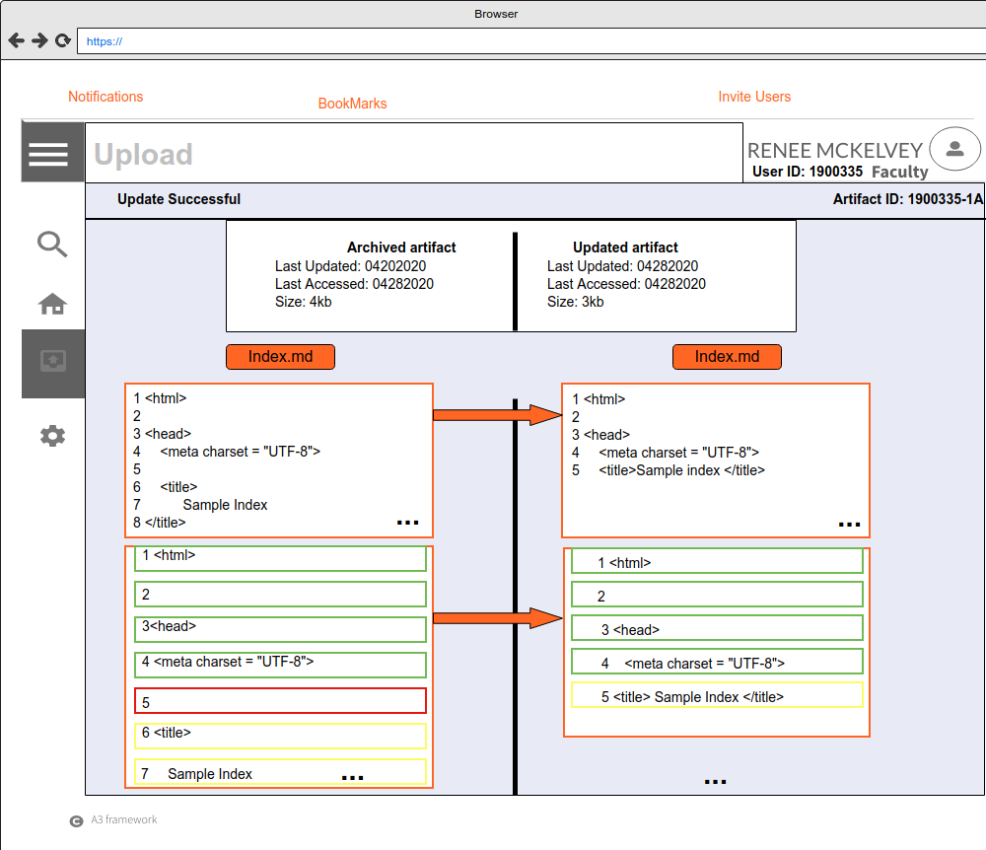
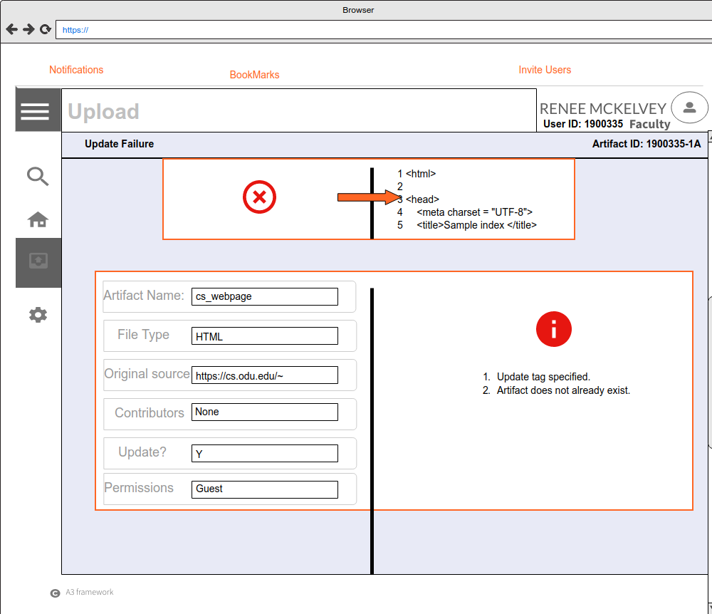
GUI MOCKUP:
Update Failed/Success

Slide 51
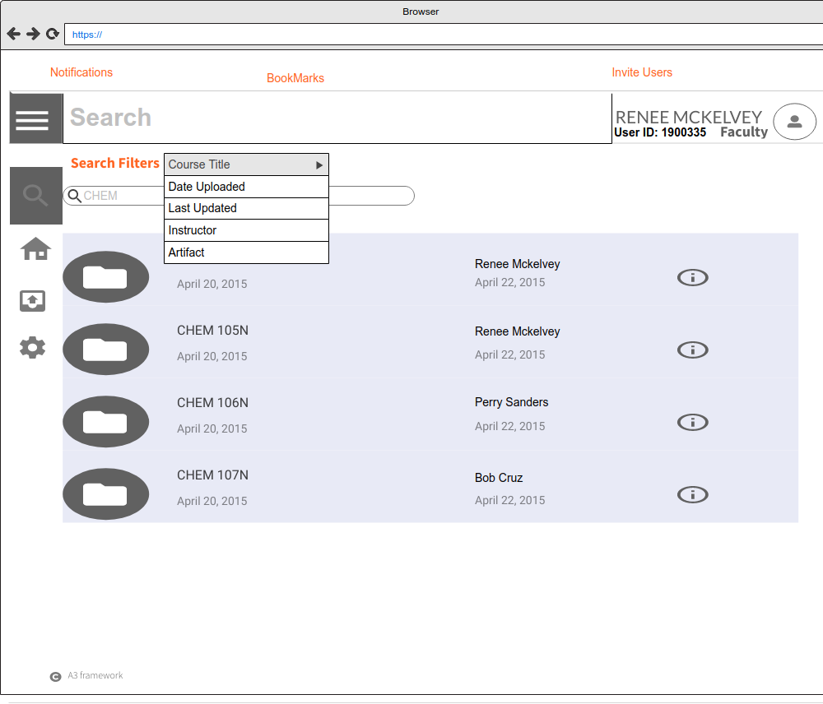
GUI MOCKUP:
Search/Search Filtering
Notes:
invite through email. is that maintain in your database?
looking for the file updated.
invitation of user in site map and algorithm ?

Slide 52
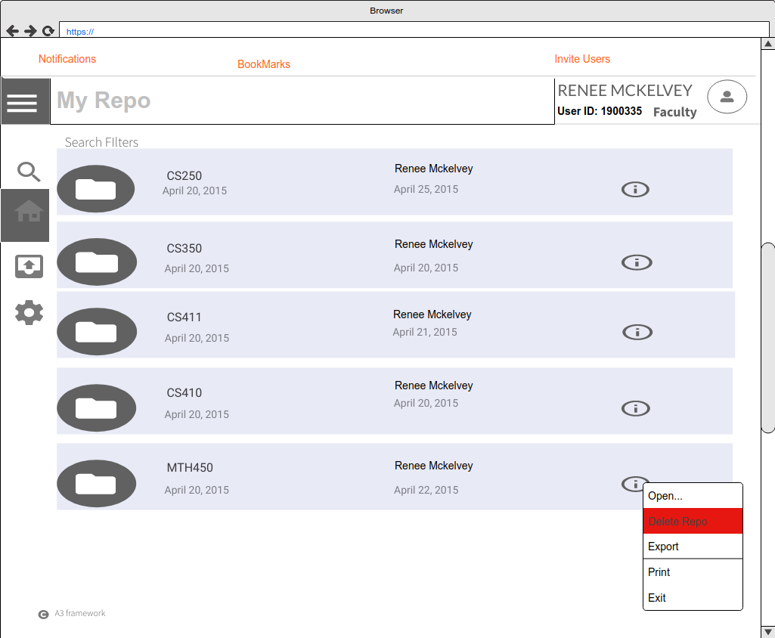
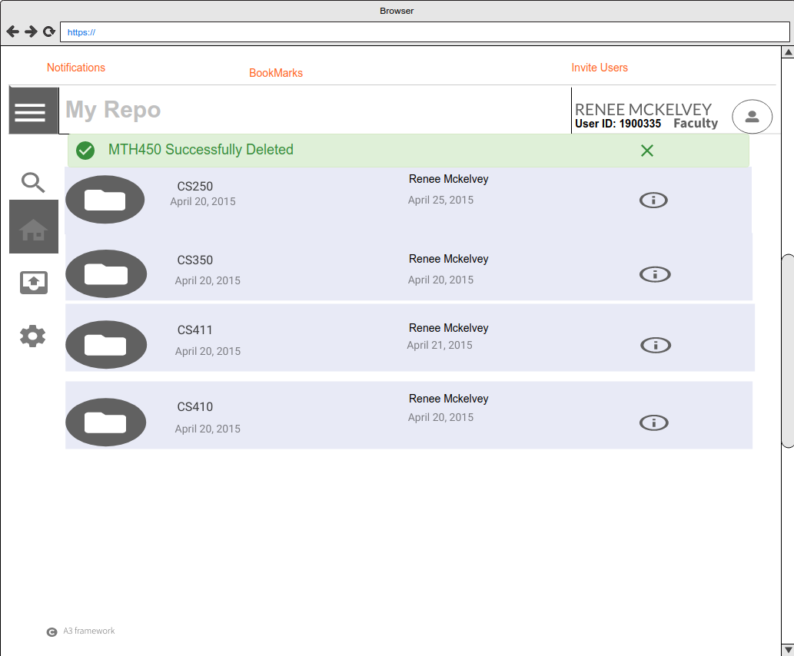
GUI MOCKUP:
Artifact Deletion

Slide 53
RISK MATRIX:
Customer & Technical
Risk ID | Title | Impact | Probability | Mitigation
T1 | Integration with Blackboard - scraping | Significant | Likely | Use of a tool similar to the Blackboard Archive Extractor. Will periodically scrape Blackboard for material and update archive.[1]
T2 | Loss or corruption of data | Significant | Unlikely | Will adhere to best practices, as defined by the National Institute of Standards and Technology.[12]
T3 | Information changes are not reported to the user | Significant | Very Unlikely | Unit Testing during development to ensure user is notified of changes.
T4 | File type are not supported | Unlikely | Moderate | List of supported file types provided and unsupported file types are stored in binary BLOB format, media will be linked to the source file and reports will be generated from a limited data set (E.g. MD5 sum, size, modified data, etc.)
C1 | Faculty does not upload material | Severe | Possible | Will make UI/UX easy to use and understand. School encourage use of A³.
C2 | Does not update material/reference | Significant | Possible | Will allow users to notify the owner if something has not been updated as well as automated notifications after a prescribed amount of time. Will allow user to see when last updated.
C3 | Inputs incorrect information | Significant | Possible | System will use backup snapshots allowing information to be reuploaded with minimal loss.
C4 | Too difficult to use | Moderate | Very Unlikely | Will utilize both a CLI and UI/UX.
Impact
 | Negligible | Minor | Moderate | Significant | Severe
Very Likely
Likely |  |  |  | T1
Possible |  |  |  | C2, C3 | C1
Unlikely |  |  | T4 | T2
Very Unlikely |  |  | C4 | T3
Probability
T#- Technical Risk
C#- Customer Risk
Notes:
Noah Jennings c1/c2 artifact is behind a secure wall?
Referring to the table and the corresponding risk analytical chart,
T1
used with BB
scraping to update
periodically scrape BB
T2
failed to notify the user
unit testing to ensure notification post changes
T3
data loss
follow NIST guidelines
T4
unsupported file types
disclose supported file types / sizes
C1
faculty fails to upload material
easy to use UI/UX
educate and motivate use of A³
C2
does not update material / reference
notify if resource has not been updated in specified amount of time
C3
Incorrect Information
Backups that are able to be reuploaded upon correction
C4
too difficult
Command line interface, user interface/experience

Slide 54
RISK MATRIX:
Security
Risk ID | Title | Impact | Probability | Mitigation
S1 | Database breach | Significant | Unlikely | The use of input validation techniques as well as input scrubbing will minimize injection and overflow style attacks from the UI.
S2 | User obtains unauthorized permission levels | Significant | Very Unlikely | The use of notifications and reports generated to notify the owner of the file upon changes made.
S3 | User uploads inappropriate material | Significant | Very Unlikely | Media will not be hosted on the A^3 server. Common terms to illicit material can be checked during report generation for obvious illicit materials.
S4 | Denial of Service | Significant | Very Unlikely | We will rely on the Host network for mitigation of DoS.
S5 | Masquerade - Replay attacks | Significant | Very Unlikely | The use of notifications and reports generated to notify the owner of the file upon changes made.
S6 | Man-in-the-middle - Intercept and forward attacks | Significant | Very Unlikely | The use of end-to-end security for the upload and download of various file types would decrease available information an attacker could obtain.
Impact
 | Negligible | Minor | Moderate | Significant | Severe
Very Likely
Likely
Possible
Unlikely |  |  |  |  | S1
Very Unlikely |  |  |  |  | S2, S3, S4, S5
Probability
S# - Security Risk
Notes:
Noah Jennings
Referring to the table and the corresponding risk analytical chart,
T1
used with BB
scraping to update
periodically scrape BB
T2
failed to notify the user
unit testing to ensure notification post changes
T3
data loss
follow NIST guidelines
T4
unsupported file types
disclose supported file types / sizes
C1
faculty fails to upload material
easy to use UI/UX
educate and motivate use of A³
C2
does not update material / reference
notify if resource has not been updated in specified amount of time
C3
Incorrect Information
Backups that are able to be reuploaded upon correction
C4
too difficult
Command line interface, user interface/experience

Slide 55
CONCLUSION
is a framework and tool set for Aggregation and Archiving of Artifacts.
Configurable for different environments
Extensible to integrate useful tools as needed
Utilizing
Normalization
Automation
Web-scraping
Archival Processes
Notes:
re-do; make it fit as a summary slide
as a simple, digestible format. quick how were fixing
hit 4 points as a highlight
Stephen Ayers

Slide 56
framework A repository of reliable resources.
Our goal is simplicity.
Notes:
Stephen Ayers

Slide 57
REFERENCES
Blackboard Archive Extractor. (2016, December 15) cs.odu.edu. Retrieved March 10, 2020, from https://www.cs.odu.edu/~cpi/old/411/crystals17/.
Carroll, J., Choo, C. W., Dunlap, D., Isenhour, P., Kerr, S., MacLean, A., & Rosson, M. (2003). Knowledge Management Support for Teachers. Educational Technology Research and Development, 51(4), 42-64. www.jstor.org/stable/30221184
Davenport, T., Long, M. & Beers, M.. (1997). Building Successful Knowledge Management Projects [Working Paper]. Retrieved March 8, 2020, from https://www.researchgate.net/publication/200045855_Building_Successful_Knowledge_Management_Projects.
Document Management Software | eFileCabinet. (2020). eFileCabinet. Retrieved February 20, 2020, from https://www.efilecabinet.com.
Domes, S. (2017). Progressive Web Apps with React: Create lightning fast web apps with native power using React and Firebase. Packt Publishing Ltd.

Slide 58
REFERENCES cont.
File Sharing and Sync For Education, Schools and Universities - FileCloud. (2020). FileCloud. Retrieved February 20, 2020, from https://www.getfilecloud.com/file-sharing-and-sync-for-education/.
GitHub Features: The right tools for the job. (2020). GitHub. Retrieved March 10,il 2020, from https://github.com/features#team-management.
Kennedy, T. (2020, January 21). Home · Wiki · Thomas J. Kennedy / cs-roars-proposal. GitLab. Retrieved 26 April 2020, from https://git-community.cs.odu.edu/tkennedy/cs-roars-proposal/-/wikis/home.
Nvlpubs.nist.gov. (n.d.). Glossary of Key Information Security Terms. From https://nvlpubs.nist.gov/nistpubs/ir/2013/NIST.IR.7298r2.pdf.
MacFarlane, J. (2006). Pandoc - About pandoc. Pandoc.org. From https://pandoc.org/index.html.
Tsapps.nist.gov. (2020). Data Loss Prevention. From https://tsapps.nist.gov/publication/get_pdf.cfm?pub_id=904672.
Xie, I., & Matusiak, K. K. (2016, July 29). Digital preservation. Science Direct (255-279). Retrieved March 10, 2020, from https://www.sciencedirect.com/science/article/pii/B9780124171121000090

Slide 59
REFERENCES cont.
Zeil, S. (2019, December 26). Building the Website. cs.odu.edu. Retrieved 26 April 2020, from https://www.cs.odu.edu/~zeil/cowem/Public/buildingTheWebsite/index.html.
Zeil, S. (2020, January 21). zeil / CoWeM - Course Websites from Markdown. GitLab. From https://git-community.cs.odu.edu/zeil/Course_Website_Management.
Brunelle J., personal communication, March 2, 2020.
Kennedy T. J., personal communication, February 12, 2020.

Slide 60
APPENDIX A

Slide 61
USER STORIES:
Guest
I must be able to :
Ability to login with MIDAS credentials
be invited by administrators or other users
obtain a student or faculty login and password
filter and sort artifacts that belong to the database
read the full material of a public artifact
I wish to be able to :
request access to private material
be notified of what type artifacts I can access (i.e. public/private)
I must not be able to :
Access private artifacts
Edit or update artifacts
Access user accounts
Modify or update public artifacts
Invite other users
Change a user’s access level

Slide 62
USER STORIES:
Student
I must be able to :
login with my MIDAS credentials
filter and sort full content of a file
access the database with my credentials off campus
access the most up to date information
search for content by keywords
I wish to be able to :
create and upload resources
Invite new users
Flag artifacts for review by the owner or administrator
if they appear to conflict with other artifacts covering the same content
if they appear out-of-date
Bookmark artifacts and repositories I will use again
Tag artifacts with keywords describing their content
I must not be able to :
Access private artifacts without invite
Edit or update artifacts I do not own
Delete user accounts
Change a user’s access level

Slide 63
USER STORIES:
Faculty
I must be able to :
login with my faculty credentials
upload artifacts
edit and update artifacts I own
set access level requirement for artifacts I own
access database off campus
create notifications for myself regarding regular updates to artifacts
request access to private resources
I wish to be able to :
Bookmark artifacts I will use again
Invite new users
Access the source of any artifact
See usage reports about artifacts I own
Tag artifacts with keywords describing their content
View information about the owner of an artifact
I must not be able to :
Access. edit, or update artifacts I don’t own
Delete user accounts
Change a user’s access level

Slide 64
USER STORIES:
Administrator
I must be able to :
Have all the capabilities of any other account type
Manage the database including:
change attributes of any artifact, such as access level requirement
remove artifacts
create and change user accounts
Test administration
View reports about users and artifacts
I wish to be able to :
Reactivate user accounts
Recover deleted files
I must not be able to :
Delete user accounts without documented
Reset passwords

Slide 65
USER STORIES:
Tester
I must be able to :
Access artifacts within my testing parameters
View reports about users and artifacts
Have administrative capabilities within my testing parameters
Analyze results
Report test problems and anomalies
I wish to be able to :
Improve software quality
Capture user requirements
I must not be able to :
Avoid testing their own products
Make all the decisions and changes to assure a better quality

Slide 66
APPENDIX B

Slide 67
Glossary:
Aggregate: Data that is composed of smaller pieces that form a larger whole.
Algorithm: Set of instructions designed to perform a specific task.
Angular: A framework for dynamic web apps. Allows for the use of HTML as a template language.
Application Programming Interface (API): Set of functions and procedures allowing the creation of applications that access features of an operating system, applications, etc.
Archive: Contains multiple files and/or folders. May be created by several different utilities and may be saved in different formats.
Artifact: Combination of arte, “by skill”, and factum, “to make”. A file or document.
Notes:
Add diff to the glossary

Slide 68
Glossary:
Backlink: A hyperlink that links from a web page, back to your own web page or website.
Blackboard: A tool that allows faculty to add resources for students to access online.
Centralized: Type of network where all users connect to a central server.
Course Websites from Markdown (CoWeM): A system for building course websites, including notes, slides, and organizational pages, from Markdown documents.
Cascading Style Sheet(CSS): Used to format the layout of web pages. Defines text styles, table sizes, among other things that previously could only be defined in HTML.
Database: Collection of information, that is organized for rapid search and retrieval.
Data Loss: An instance in which information is destroyed by failures or neglect.

Slide 69
Glossary:
Diff: A line by line comparison of normalized artifacts.
Docker: Tool to create, deploy, and run applications by using containers. Allow developers to package up an application, with all parts needed, to be deployed in one package.
Export: Taking data from one program or computer to another.
GitLab: Used to provide internal management of git repositories. Is a self hosted Git-repository management system that keeps the user code private.
GUI: Graphical User Interface - User interface that contains graphical elements. Examples include windows, icons and buttons.
Hypertext Markup Language (HTML): A language used to create web pages. “Hypertext” refers to hyperlinks in a page, and “Markup language” refers to the way tags are used to define page layout.

Slide 70
Glossary:
Hyperlink: An element that links to another file or object.
JavaScript (JS): A language used in web development. While influenced by Java, It’s syntax is more similar to C.
Knowledge Management: The management process of creating, capturing, sharing, retrieving, and storing data, information, knowledge experiences and skills by using appropriate information and network technology.
Markdown: A markup language that can be used to format plain text. Can be converted into another language.
Markup: A language that uses tags to define elements within a document.

Slide 71
Glossary:
MySQL: Open source SQL database management system. Developed and distributed by Oracle Corporation.
Normalization: Converting ingested objects into a small number of pre-selected formats.
Python: An interpreted, object-oriented language.
Personal Learning Environment (PLE): An interface used in flexible online courses. Designed by ODU’s Center for Learning and Teaching.
pydoc: Automatically generates documentation from Python modules. Can be presented as pages of text on the console, served to a web browser, or saved to HTML files.
Pylint: A Python static code analysis tool. Looks for programming errors and warnings from within the code, as well as from an extensive configuration file.

Slide 72
Glossary:
React: A JavaScript library that is used to create User Interfaces for web applications.reStructuredText: A plaintext markup syntax and parser system. Useful for in-line program documentation.
Secure File Transfer Protocol (SFTP): Secure version of File Transfer Protocol. Facilitates data access and data transfer over a Secure Shell data stream
Sphinx: A Python documentation generator. Converts reStructuredText files into HTML websites and other formats.
Tags: Is a keyword or term assigned to a piece of information.
tox: Aims to automate and standardize testing in Python. Is a generic virtualenv management and test command line tool.
Visual Studio Code: A source code editor that runs on Mac, Linux, and Windows.

Slide 73
APPENDIX C

Slide 74
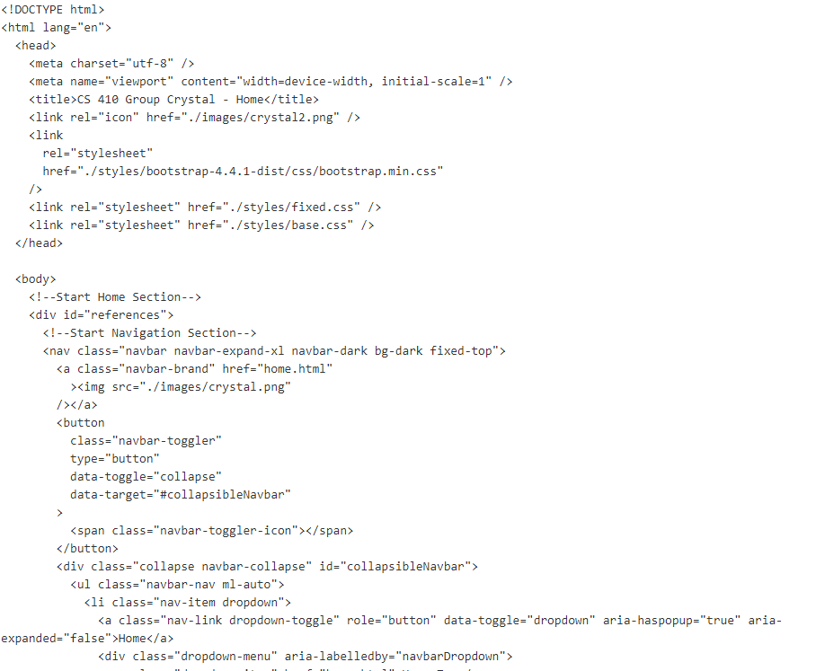
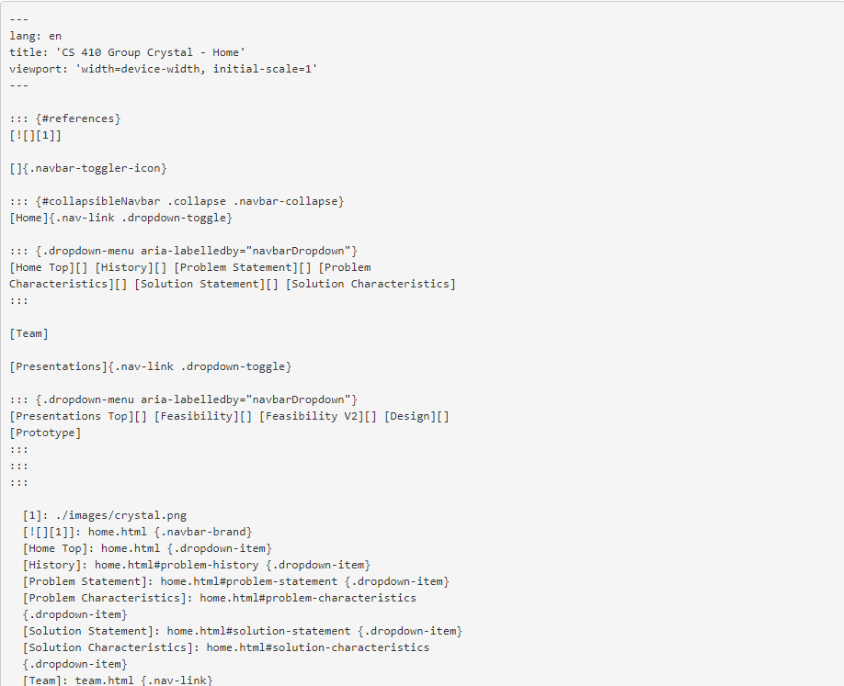
Normalization Example:
From HTML
To Markdown

Slide 75
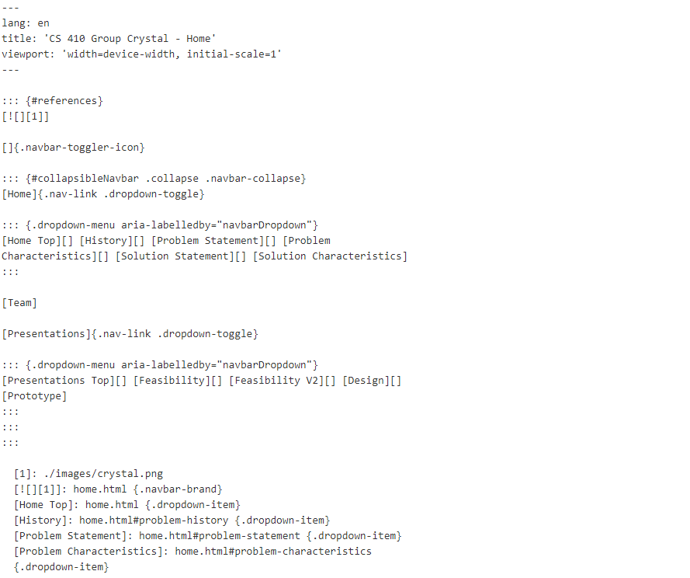
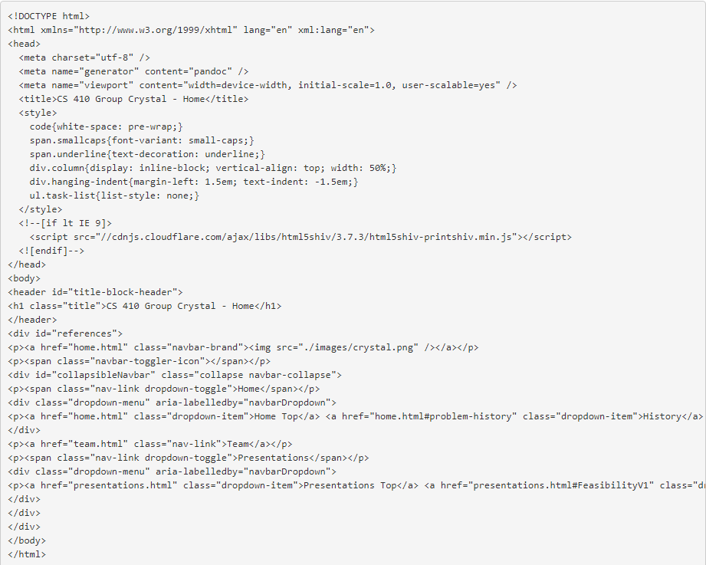
Retrieval Example:
From Markdown
To HTML5

Slide 76
Security Algorithm Permissions
Request to apply permissions
Request made by instructor level or higher
No
A generalized, basic security check
Permission levels of each user, regardless of level will be checked before data level actions are taken
Readability permissions will be checked and granted on login
Yes
Reject request
No
Updating an old file?
Yes
Artifact permits or owned by requestor?
No
Yes
Uploading a new file?
Yes
Data Retrieval Algorithm
User Upload
Permission
granted
Notes:
extra?

Slide 77
Deletion Algorithm
No
Request to delete artifact/repo
Owned artifact?
No
Yes
Reject request
Remove artifact visibility
Store current artifact state
Check deleter permissions
Strip visibility from artifact
Archive resource
Notes:
needs failure end box
alg_sort
cin >> tags_user_input //allows multiple entries
if (tags_user_input == "")
//depending on search parameters
return all artifacts
else if (tags_user_input != regex formatting check)
return error message
print all artifacts from (query A3.tag where tags_user_input is TagName)

Slide 78
Notification Algorithm:
Invite
Request to add users to artifact contributors list
User owned artifact?
Yes
Gather user(s) emails/IDs
No
Reject invite
No
Users exist?
Upon owners request
Gather user emails and email interactive invitations
Once accepted, they are added to the artifacts contributors
Permitted further levels of access
Yes
No
Add user to artifact contributors list
Yes
Gather user confirmation
Invite users
Notes:
alg_sort
cin >> tags_user_input //allows multiple entries
if (tags_user_input == "")
//depending on search parameters
return all artifacts
else if (tags_user_input != regex formatting check)
return error message
print all artifacts from (query A3.tag where tags_user_input is TagName)

Slide 79
Notification Algorithm:
Alteration
Successfully altered artifact state
Gather allowed users
After a successful update/deletion of an artifact
Gathers and notifies contributors
Issues interactive email notification
Notify users of change
Yes
User(s) recognized?
No
Reject notification
Notes:
alg_sort
cin >> tags_user_input //allows multiple entries
if (tags_user_input == "")
//depending on search parameters
return all artifacts
else if (tags_user_input != regex formatting check)
return error message
print all artifacts from (query A3.tag where tags_user_input is TagName)

Slide 80
Data Retrieval Algorithm:
User Export
Desire to export artifact
User accessible or owned artifact/repo?
No
Reject export
Yes
Creates ability for users of all levels to exported needed artifacts
Normalized artifacts will be converted to original formatting while non-normalized artifacts will be exported as original file type
Export artifact
Artifact normalized?
No
Yes
Denormalize to original file type
Notes:
alg_sort
cin >> tags_user_input //allows multiple entries
if (tags_user_input == "")
//depending on search parameters
return all artifacts
else if (tags_user_input != regex formatting check)
return error message
print all artifacts from (query A3.tag where tags_user_input is TagName)

Slide 81
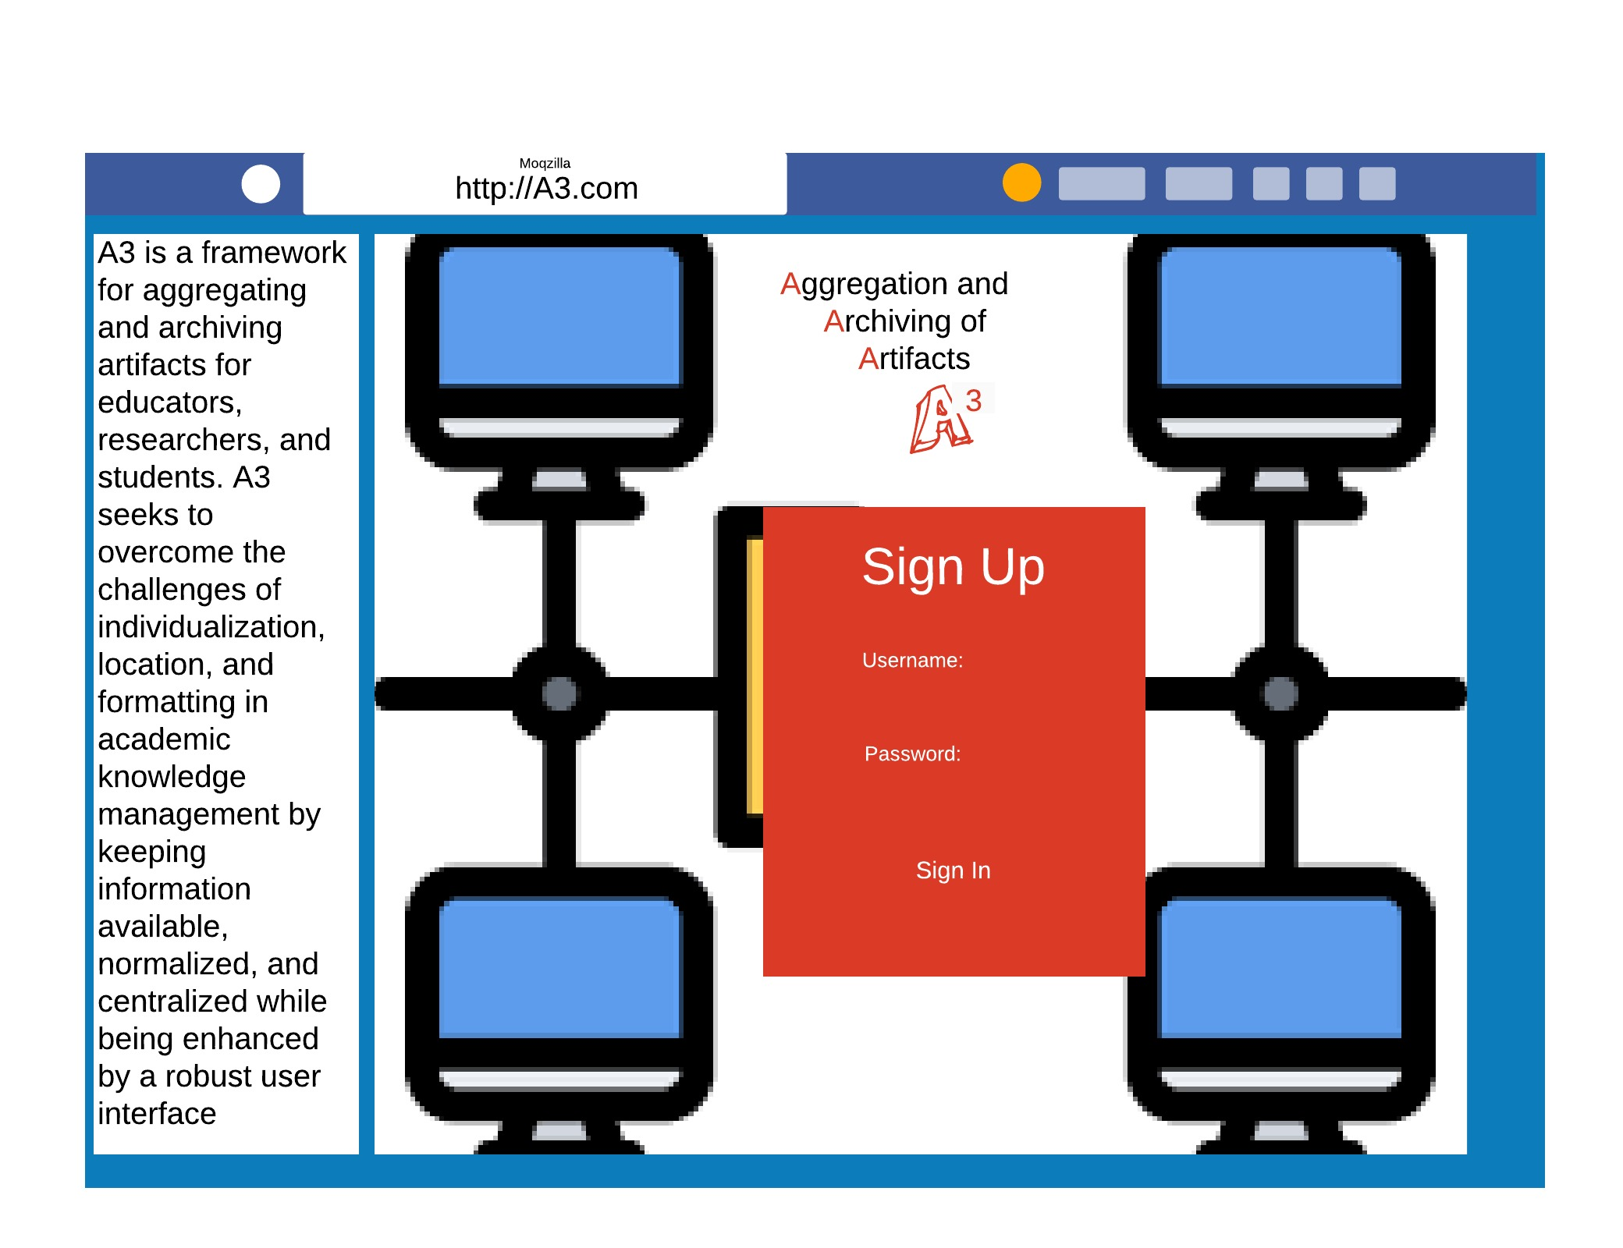
GUI MOCKUP & PROTOTYPE
Notes:
Noah Jennings

